Slide 1
Cardiovasicular system pathology
Third class
Dr. yasmeen jasim
Lectures of pathology
practical

Slide 2
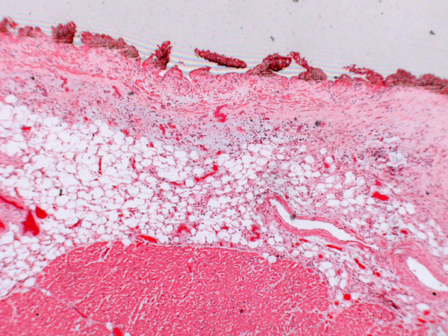
Organ : Heart
Diagnosis : pericarditis
Lesions: A layer of fibrin covers the surface of inflamed pericardium as membrane with infiltration of inflammatory cells. Congested blood vessels.

Slide 3
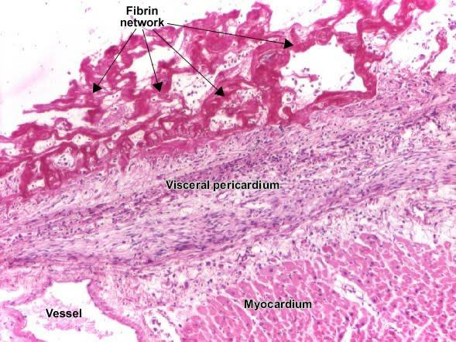
Organ : heart
Diagnosis: Fibrinous pericarditis
Lesions: The pericardium is distorted by thick irregular layer of pinkish fibrinous exudate (fibrin network) with some red cells and inflammatory cells infiltration in the visceral layer as a high numbers.

Slide 4
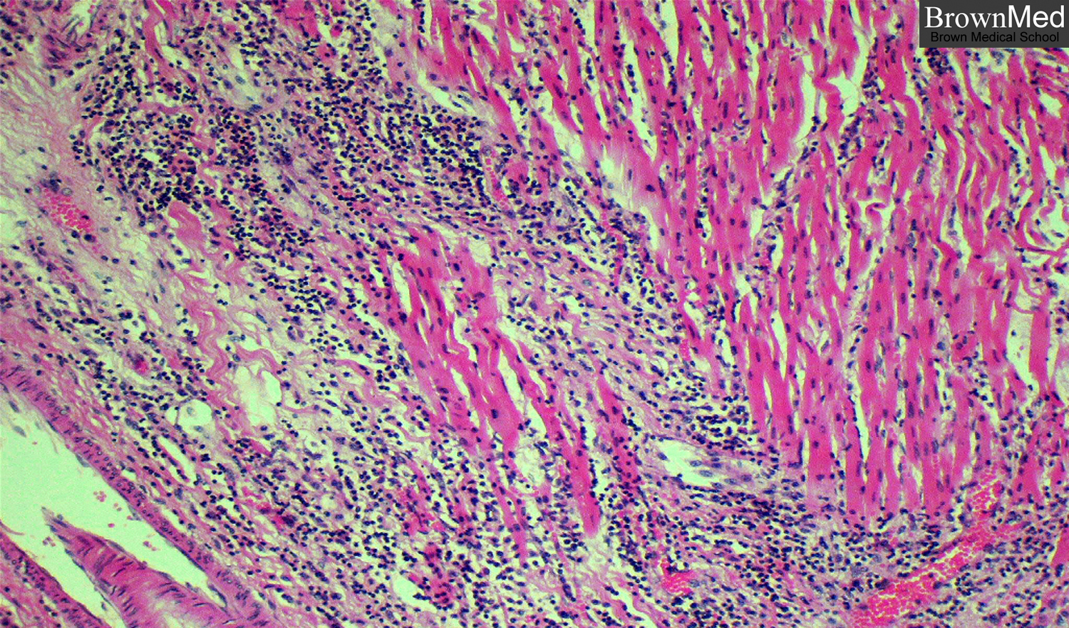
Organ : Heart
Diagnosis : myocarditis
Lesions: degeneration and necrosis of myocytes in large area with inflammatory cells infiltrate in high numbers . In this case of viral myocarditis, the infiltrate is predominantly lymphocytic.

Slide 5
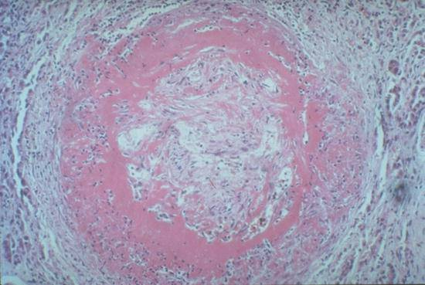
Organ : Artery
Diagnosis : arteritis or arteriosclerosis
Lesion : presences of pinkish material or eosinophilic "fibrinoid" involving the intima and media of this muscular artery. With infiltration of inflammatory cells Notice also how the lumen has been occluded by granulation tissue.

Slide 6
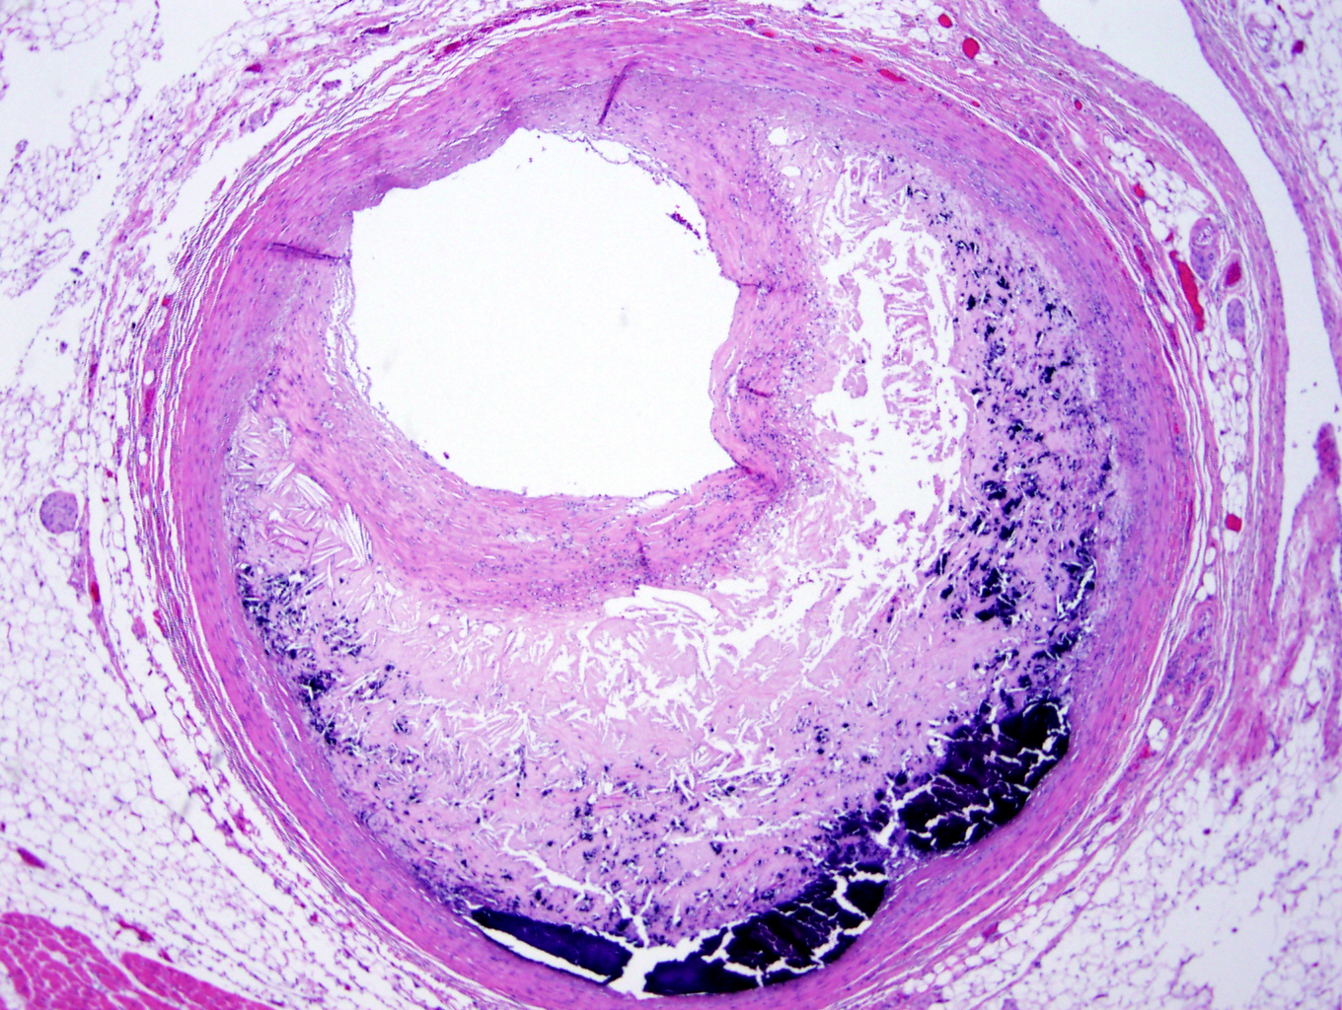
Organ: Artery
Diagnosis : atherosclerosis
Lesions : the artery appear thick wall and presences of lipid depositions into intimal layer and calcified that appears as blue area.

Slide 7
Phlebitis
Phlebitis means inflammation of a vein.
Phlebitis Causes
Injury to a vein increases the risk of forming a blood clot.

Slide 8
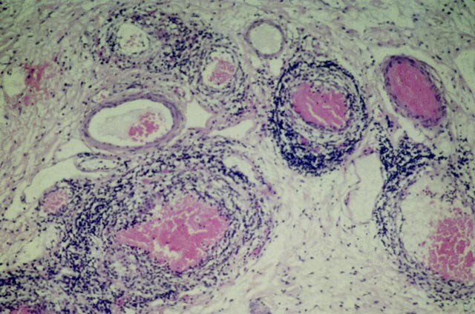
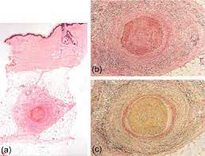
Infiltration inflammatory cells thickening in wall and insert thrombi in lumen

